Slide 1
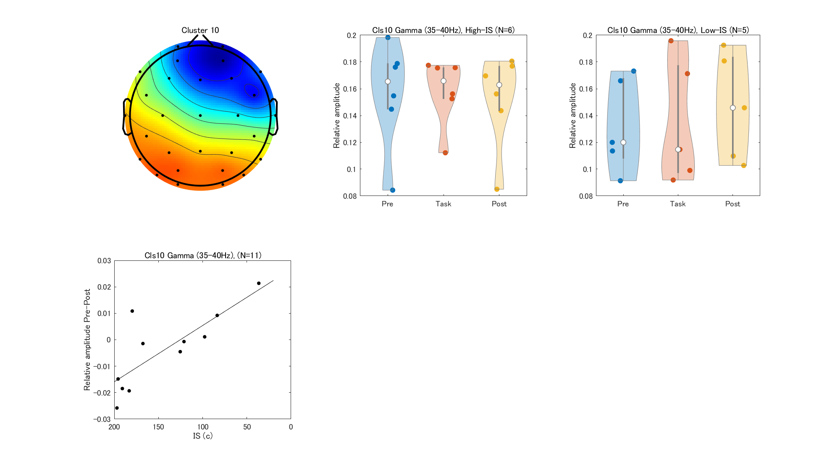

Slide 2


Slide 3
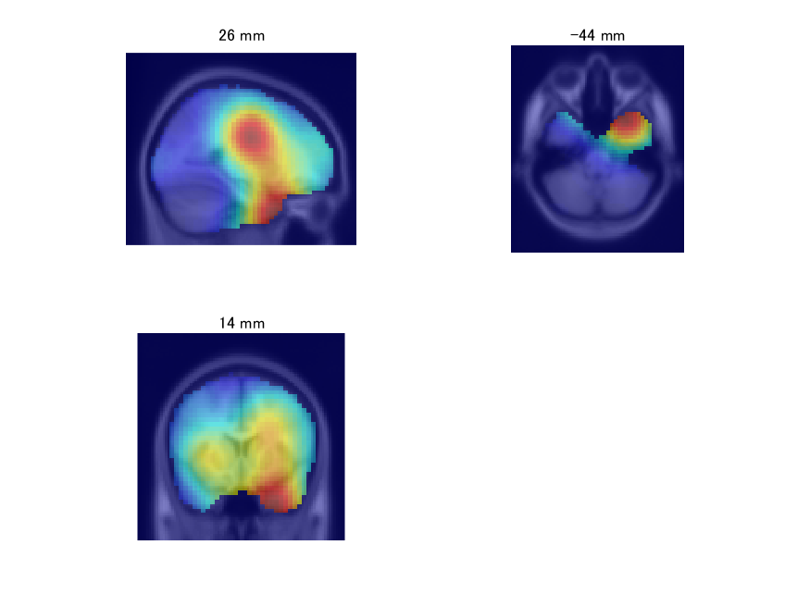
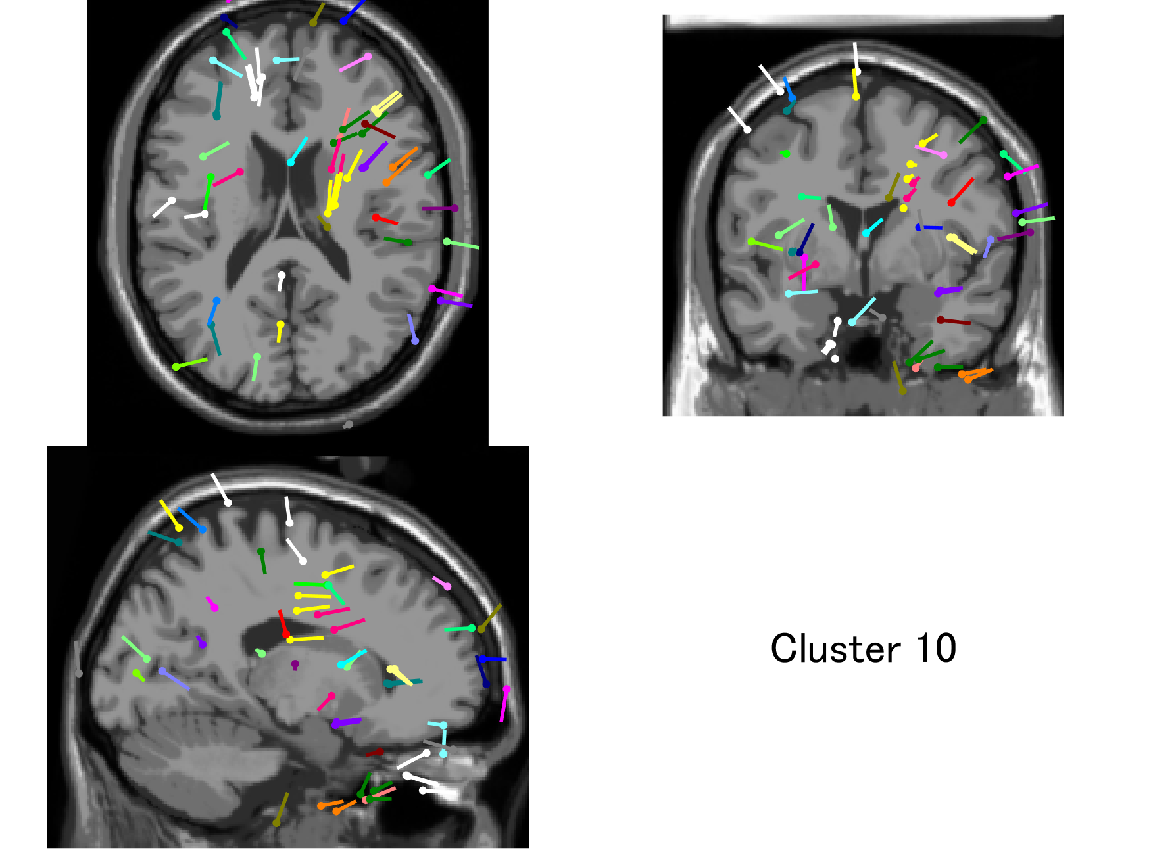
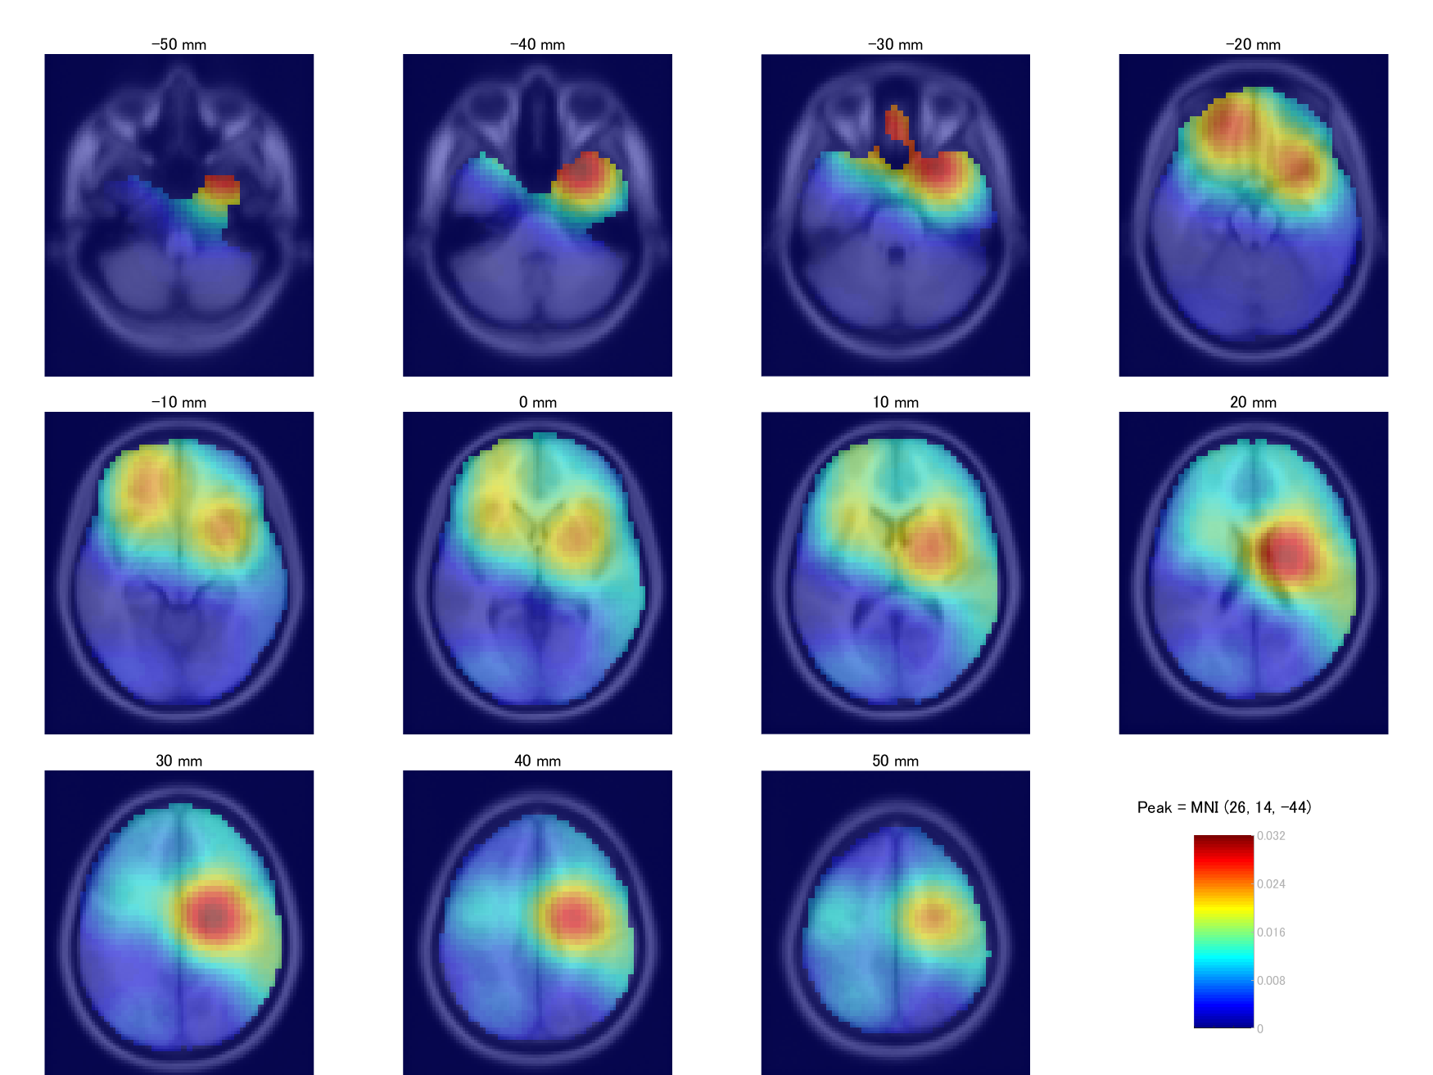

Slide 4
Increased insula coactivation with salience networks in insomnia
https://www.sciencedirect.com/science/article/pii/S0301051114000192
Gamma-Band Oscillations Preferential for Nociception can be Recorded in the Human Insula
https://academic.oup.com/cercor/article/28/10/3650/4210990?login=true

